Slide 1
EDA Project Overview:
Vehicle Sales and Market Trends
Name: Blessing Odume

Slide 2
Overview
Background
Aims and Objective
Analysis
Findings
Recommendation

Slide 3
Background
One of the biggest and most active industries in the world, the global vehicle sales sector greatly boosts national economies, creates jobs, and advances technology. Vehicle sales have fluctuated significantly over the past few decades as a result of shifts in consumer preferences, technology advancements, global upheavals, and economic situations. Gaining knowledge about vehicle sales and market trends will help to understand customer behavior, the expansion of the industry, and the difficulties automakers confront in a quickly changing environment.

Slide 4
Aim and Objective
The aim of this exploratory data analysis is to uncover market trends, understand pricing dynamics, and explore factors influencing vehicle sales. The objectives are:
To identify trends in vehicle sales over time.
To analyze the impact of vehicle condition and mileage on selling prices.
To understand the relationship between MMR values and actual selling prices.
To understand the relationship between MMR values and actual selling prices.
01
02
03
04

Slide 5
ANALYSIS

Slide 6
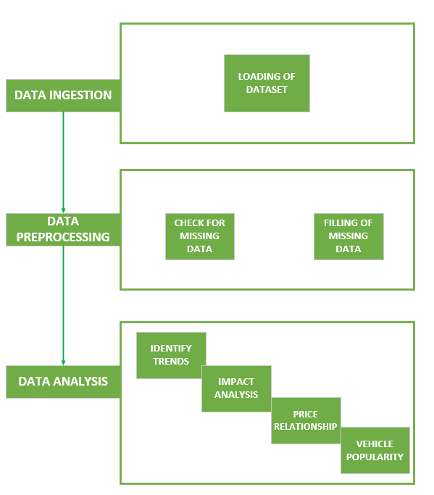
METHODOLOGY

Slide 7
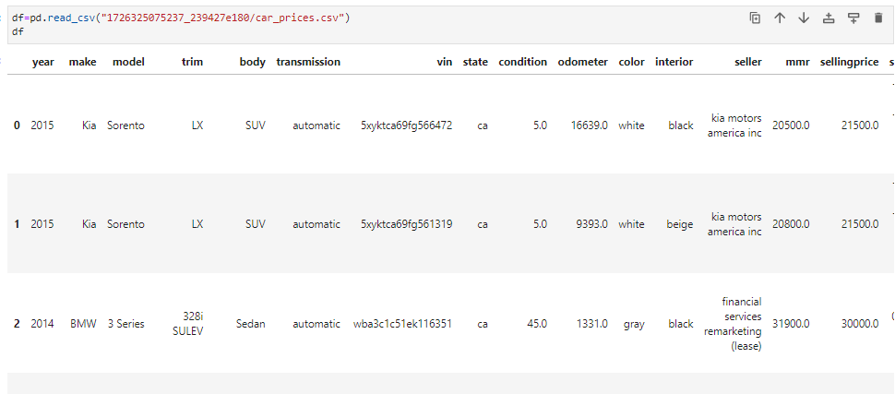
DATA INGESTION
The dataset which includes sales transaction data for various vehicles was loaded into the python development environment (Jupyter notebook) using the pandas library. The output of the loaded data is shown in the figure below:
Figure 1: Data ingestion

Slide 8
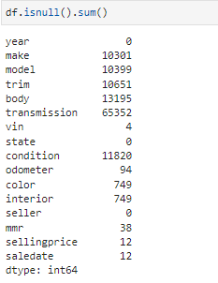
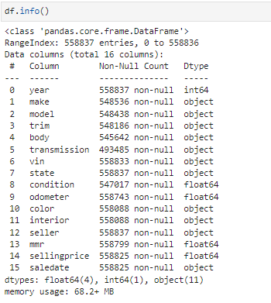
DATA PREPROCESSING
The ingested dataset was preprocessed, this include checking for missing values and duplicates in the dataset entry. There wasn’t a duplicate copy of any data entry but there were good numbers of missing data in the dataset. The figure below show the number of missing cells in each column.
Figure 2: Number of missing data in each column
Figure 3: Column data type

Slide 9
DATA PREPROCESSING CONT’D
3.1 Vin (Vehicle Identification Number): The total number of instance in the dataset is 558837. There were four (4) missing data in Vin column of the dataset. The missing data entry was filled with the highest occurring value in the Vin column which is “automatic”.
This column is very crucial in the analysis of the dataset as it contain the important information about each instance of the vehicle present in the dataset.
3.2 year, seller and state: The year, seller, and state column does not have any missing cell and they represent the year of production, seller and state of registration respectively.
3.3 Make: The make column represent the manufacturer name and it has 10301 number of missing cells. However, this was fix by extracting the first four characters of the Vin (manufacturer number) and search for match among the filled cell in the make column. Four characters was used because some manufacturers happen to share the same manufacturer number a case like the parent and child company, Hyundai and Kia.

Slide 10
DATA PREPROCESSING CONT’D
3.4 Model: The model column represent the vehicle model and it has 10399 number of missing cells. However, this was fix by slicing through the four and 8 characters of the Vin (model, engine, trim) and search for match among the filled cell in the model column. Four characters was used because some manufacturers happen to share the same model, engine and trim identification.
3.5 Trim, body, condition and transmission: There were 10651, 13195, 11820, 65352 missing cells in trim, body, condition and transmission column respectively. These four (4) features represent the vehicle details and specification. However, the missing cells were filled with the highest occurring value in each of the columns.
3.6 Make: The make column represent the manufacturer name and it has 10301 number of missing cells. However, this was fix by extracting the first four characters of the Vin (manufacturer number) and search for match among the filled cell in the make column. Four characters was used because some manufacturers happen to share the same manufacturer number a case like the parent and child company, Hyundai and Kia.

Slide 11
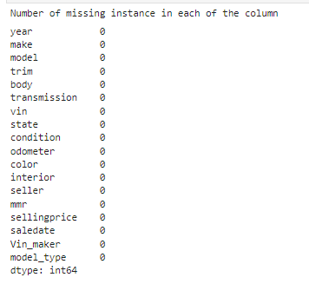
DATA PREPROCESSING CONT’D
3.7 Odometer, color and interior: These columns have a negligible number of missing cells in the dataset which ranges from 100 to 800. These missing cells were filled with the highest occurring values in each column.
3.5 MMR, Sellingprice and saledate: These columns represent market price estimate, the vehicle selling price and the date the vehicle was sold. Also, these three features have negligible number of missing instances and they were filled with the highest occurring instance in the column.
The figure below show the outcome of the data preprocessing:
Figure 3: Number of missing data in each column

Slide 12
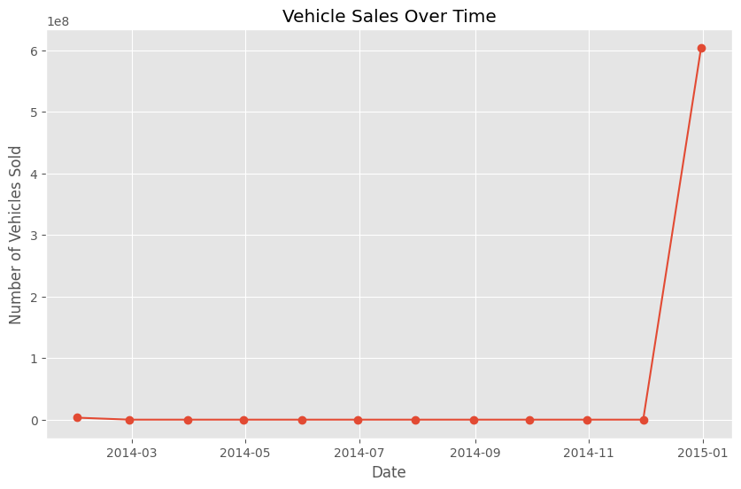
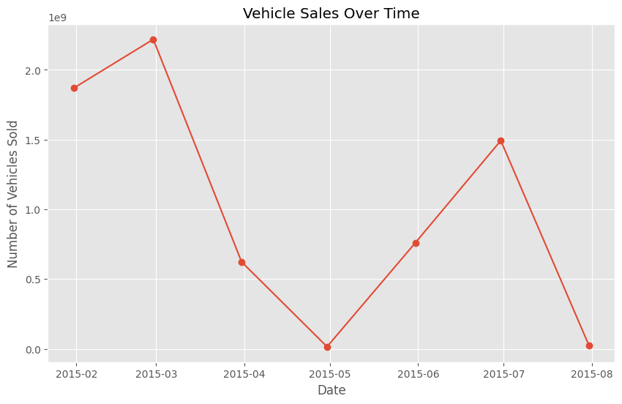
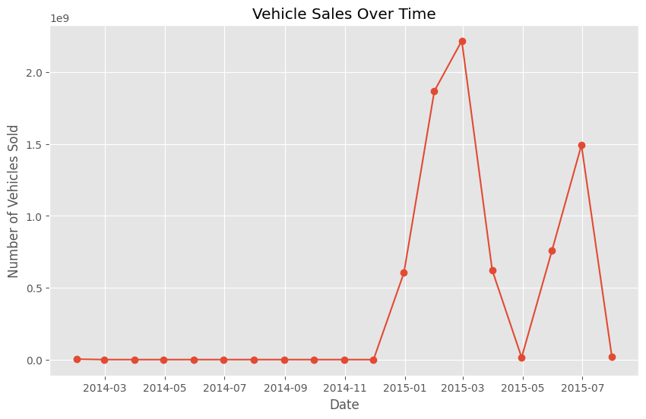
DATA ANALYSIS
Here, the analysis of the dataset is shown and explained.
Identify trends in vehicle sales over time.
To identify sales trend over time using the dataset, the sales time column and the selling price were used. The sales time column was converted from object data type to datetime format. Figure 4 show the sales trend in year 2014, figure 5 show the sales trend in the year 2015 and Figure 6 display the sales trend in the whole dataset.
Figure 5: Sales trend for year 2015
Figure 6: Overall vehicles sale trend
Figure 4: sales trend for year 2014

Slide 13
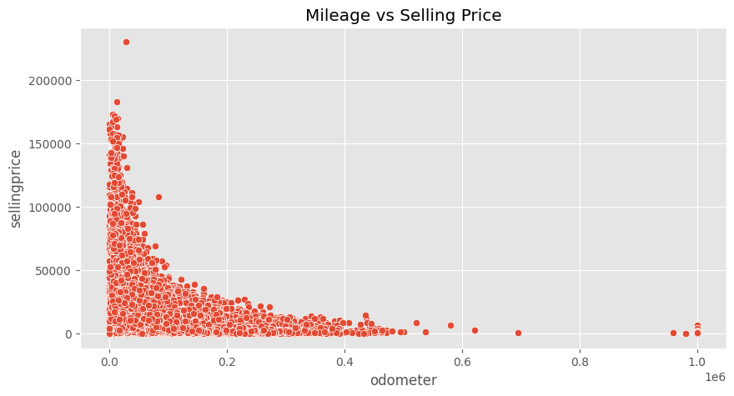
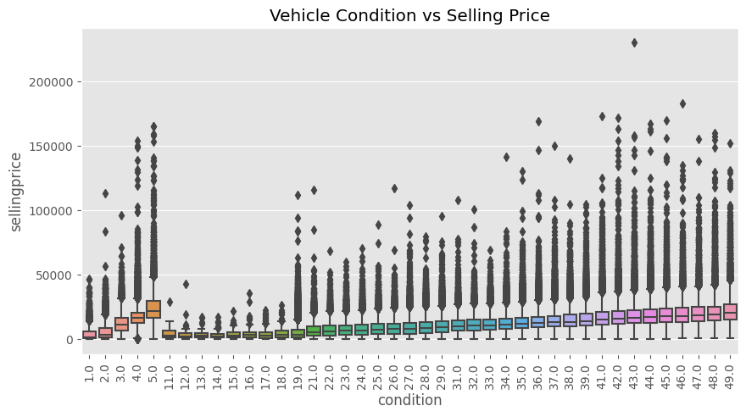
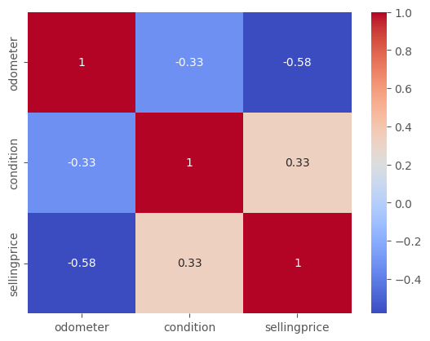
DATA ANALYSIS CONT’D
2) Analyze the impact of vehicle condition and mileage on selling prices.
The impact of vehicle condition and mileage on the selling price of vehicles was analyzed using the scatter plot, box plot and correlation coefficient. To do this the condition and the odometer column datatype was converted from object to float data type. Figure 7 show the scatter plot, figure 8 show the box plot while Figure 9 display the correlation plot.
Figure 7: Scatter plot for mileage and price
Figure 8: Box plot for condition and price
Figure 9: Correlation plot for mileage, condition and price

Slide 14
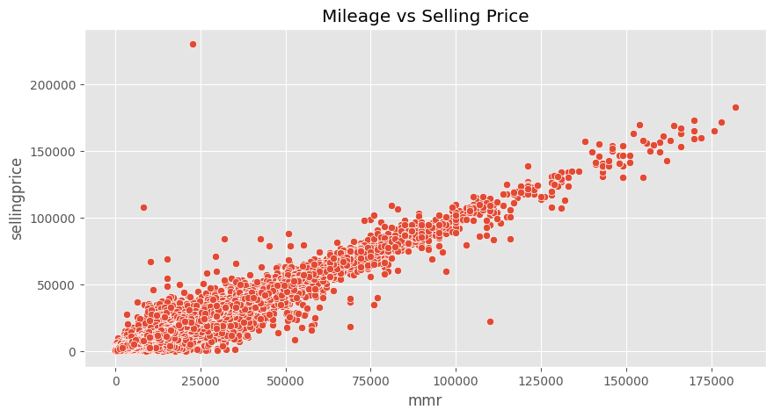
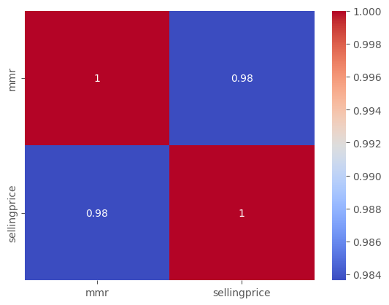
DATA ANALYSIS CONT’D
3) Understand the relationship between MMR values and actual selling prices..
The relationship between the market value estimate and the selling price of the vehicle was done using the scatter plot and correlation coefficient. The two columns (mmr and sellingprice) were use to plot the relationship between them.
Figure 10: Scatter plot MMR and selling price
Figure 11: Correlation plot for MMR and selling price.

Slide 15
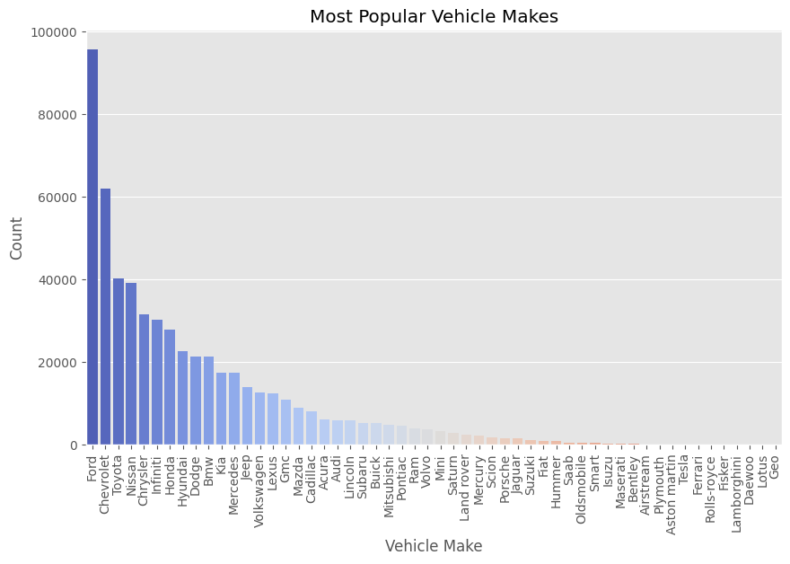
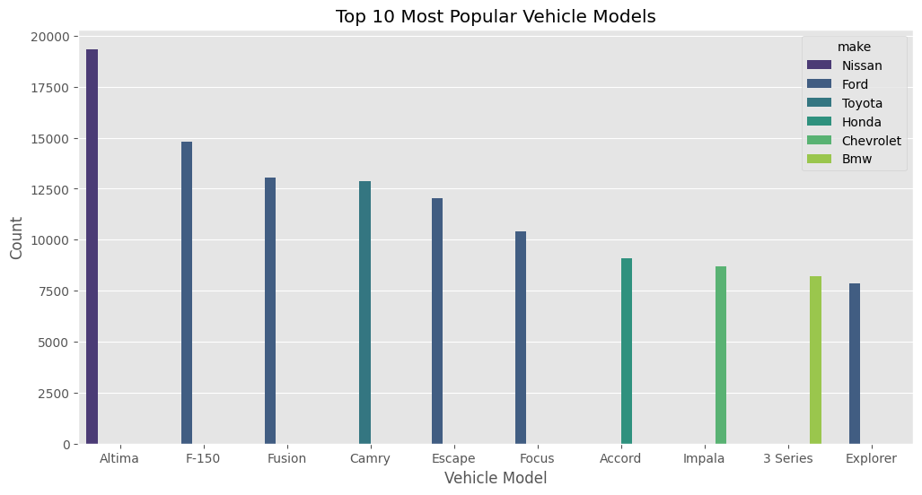
DATA ANALYSIS CONT’D
4) Determine the most popular vehicle makes and models.
The most popular vehicle maker and models are shown in the figure below. The make and model column were plotted against count. This gave me the popular maker and model.
Figure 12: Popular vehicle
Figure 13: Popular models

Slide 16
FINDINGS

Slide 17
FINDINGS
It was noticed from the analysis of the data that there was a surge in the sales of vehicle at the end of the year around December 1 till march of the following year. Also, a drastic fall of sales of vehicle was noticed in the beginning of march which extended to sometime around April ending. It is be concluded from this analysis that sales of vehicle increase at the end of the year which might be as a result of high travels that usually happen around this time.
The condition of the vehicle and it mileage reading affects the cost price of the vehicle. It can be seen from the visualization that the higher the mileage reading of the vehicle the lower the cost price and vice versa. Also, for the condition of the vehicle, it has a positive correlation with the vehicle cost price while the odometer reading has a negative correlation with the vehicle selling price.

Slide 18
FINDINGS CONT’D
3) It relationship of the market value estimate with the actual selling price is a positive one. The Pearson correlation gave 0.98 correlation value. This means that the higher the MMR estimate the higher the selling price.
4) The most popular vehicle according to the analysis done is the ford because it has a higher number of purchase when compared to other vehicle. While the most popular model is the Altima because of the higher numbers of users.

Slide 19
RECOMMENDATION
From the result of this analysis it is recommended that the trend for higher sales of vehicle is always toward the end of the year and it is suggested that there should be more product (Vehicles) readily available around this period. However, this analysis also show that not only that vehicles should be available for sale but vehicles that are popular among the population like the ford products and Nissan, Altima brand to be specific. In addition while purchasing vehicles for sale it is important to take note of the car specifications that affect the selling price. This specifications ranges from the mileage i.e. odometer reading, and vehicle condition. Lastly, it is recommended that the market value estimates of vehicles should be kept in check to have idea about the current selling price.

Slide 20
THANK YOU

